Slide 1
Townsend MBTA COMMUNITIES
M.G.L. Ch. 40A Section 3A
ACTION PLAN & COMPLIANCE
Prepared & Presented by Jonathan Vos, Regional Planner, MRPC

Slide 2
REQUIREMENTS OF SECTION 3A
Section 3A.
(a)(1)…have a zoning bylaw that provides for at least one district of reasonable size in which multi-family housing is permitted as of right…
…A district of reasonable size shall:
(i) Have a minimum gross density of 15 units/acre
(ii) Be located not more than 0.5 miles from a commuter rail station, subway station, ferry terminal or bus station, if applicable.

Slide 3
REQUIREMENTS OF SECTION 3A cont.
Section 3A.
(b) An MBTA community that fails to comply with this section shall not be eligible for funds from:
(i) the Housing Choice Initiative...;
(ii) the Local Capital Projects Fund…; or
(iii) the MassWorks infrastructure program...
(c) The department…shall promulgate guidelines to determine if an MBTA community is in compliance with this section.

Slide 4
MBTA communities with no land area within 0.5 miles of a transit station:
–The multi-family district should be located in an area with reasonable access to a transit station based on existing street patterns, pedestrian connections, and bicycle lanes, or near an existing downtown, village center, or an area of concentrated development.

Slide 5
Requirements for Townsend
Townsend must create (but not build) dense multifamily zoning to be compliant with Section 3A.
As an Adjacent Small Town, the deadline to be compliant is December 31, 2025.
No requirement for specific location of compliant zone in Townsend.
Must zone for at least 178 multi-family units at a density at 15 units/acre (approximately 12 acres).
The MBTA Communities Zone must be as-of-right and cannot have restrictions such as being age-restricted housing.
Can use an Overlay Zoning District.
Zone does not have to be contiguous.

Slide 6
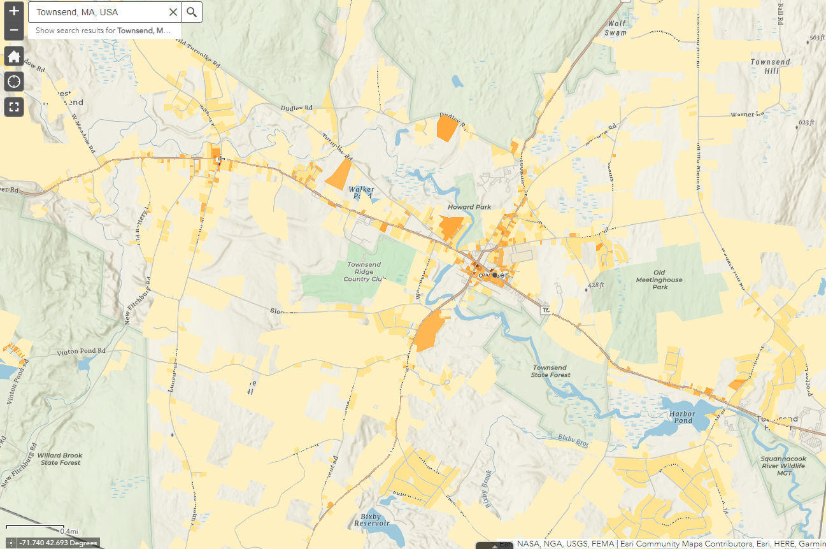
An overview snapshot of Townsend’s current housing unit density by parcel.
Currently, majority of housing units are single family, with an average parcel density of .5 units per acre.
Source: TODEX, mhp.net

Slide 7
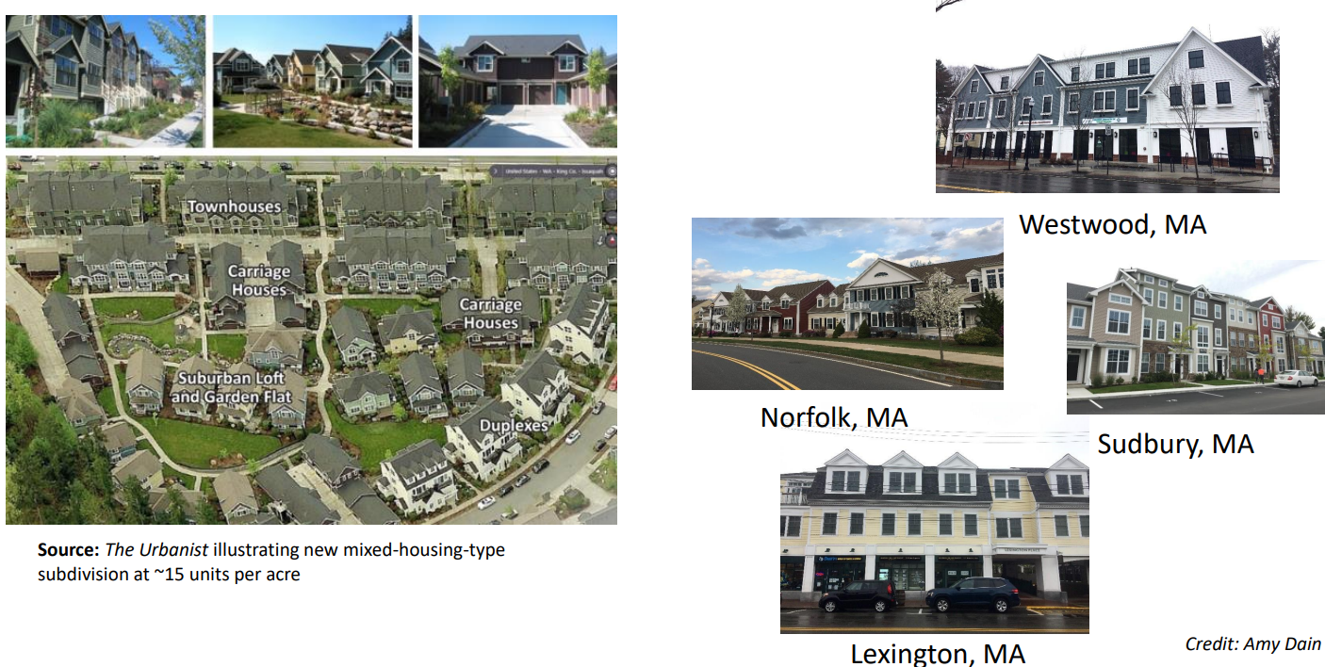
Example dense development (15 Units/acre)

Slide 8
Next Steps
Evaluate parcels and current or future land use in Townsend for possible sites to include within any MBTA Zone.
Determine what type of zoning mechanism to use to become MBTA Compliant (Smart Growth, Overlay, etc.).
Use Compliance Model to test proposed parcels and zones.

Slide 9
QUESTIONS?

